Slide 1
Markov Blanket Causal Discovery Using Minimum Message Length
Kelvin Yang Li
Supervisors: Dr Kevin Korb, Dr Lloyd Allison, Dr Francois Petitjean
Monash University
November 25, 2015

Slide 2
Content
Background
Causal discovery
Main approaches
This project
Markov blanket
MML
Notes:
Considering if add experiment part

Slide 3

What is causality?
X causes Y iff intervention on X affects distribution of Y.
For example, irrigation leads to the result of beautiful lawn.
Allow multiple causes and effects.
Irrigation
Fertilizer
Sunlight
Beautiful flowers
Beautiful lawn
Notes:
These causes are first order or higher order causes?

Slide 4
Correlation ≠ Causation
X and Y are correlated does not necessarily imply one is a cause of the other.
But correlation is necessary for causation.
Irrigation
Wet feet
?
Beautiful lawn
X
Y
X
Y
Z
X
Y
Notes:
Change question mart to “no” mark

Slide 5

How to find causality?
Randomized Controlled Trail (RCT) is
A type of scientific experiment;
Often considered as the gold standard.
Intervention
RCT
X
?
Y

Slide 6


However, RCT is not always applicable in real life.
RCT
Annual rainfall in Jamaica
?
Dominance in the sprints
RCT
Spending time with a smoking friend
?
Lower one’s IQ

Slide 7
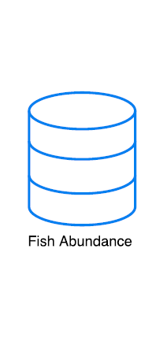
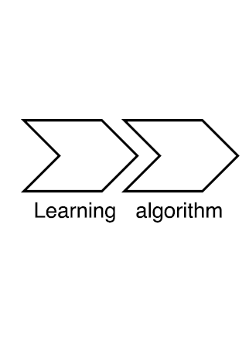
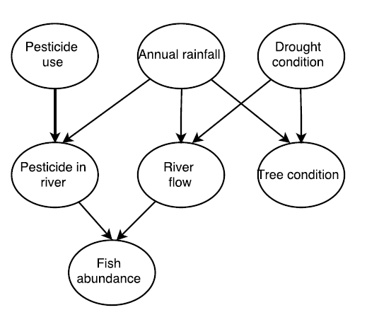
What is causal discovery?
Finding the underlying causal model from purely observational data.
Avoid problems such as time and costs, ethics and limitations of external validity.
A causal model is graphically represented by a directed acyclic graph (DAG).

Slide 8
Is causal discovery possible?
Yes! But only within the space of equivalent classes!
Two equivalent classes
Equivalent classes can be distinguished by testing the conditional independency Ind(X, Y|Z).
X
Y
Z
X
Y
Z
X
Y
Z
X
Y
Z
X
Y
Z
Notes:
Add a structure of x-y-z without diretions
Merge the next slide with this slide

Slide 9


Is causal discovery possible?
Yes! But only within the space of equivalent classes!
Two equivalent classes
Equivalent classes can be distinguished by testing the conditional independency Ind(X, Y|Z).
X
Y
Z
X
Y
Z
X
Y
Z
X
Y
Z
X
Y
Z
Dep(X, Z|$∅$)
Ind(X, Z|$∅$)
Notes:
Add a structure of x-y-z without diretions
Merge the next slide with this slide

Slide 10
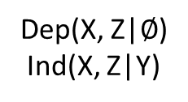
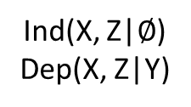
Is causal discovery possible?
Yes! But only within the space of equivalent classes!
Two equivalent classes
Equivalent classes can be distinguished by testing the conditional independency Ind(X, Y|Z).
X
Y
Z
X
Y
Z
X
Y
Z
X
Y
Z
X
Y
Z
Dep(X, Z|$∅$)
Ind(X, Z|Y)
Ind(X, Z|$∅$)
Dep(X, Z|Y)
Notes:
Add a structure of x-y-z without diretions
Merge the next slide with this slide

Slide 11
How to learn causal models?
Constraint-based approach:
Search-and-score approach:
Building a DAG according to statistical tests of conditional independencies;
Algorithms: PC (Spirtes and Glymour, 1991), TPDA (Cheng et al., 2002), MMHC (Tsamardinos, 2006), etc.
Searching for a DAG with the optimal score given by a scoring function.
Algorithms: K2 (Cooper and Herskovits, 1992), BDe (Heckerman and Geiger, 1995), CaMML (Wallace and Korb, 1996), etc.

Slide 12
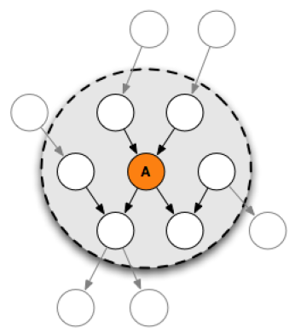
Markov Blanket
The Markov blanket (MB) of a target variable is the minimum set of variables given which the target is conditionally independent of the rest of the variables.
MB is the minimum but most informative set for a target variable.

Slide 13
Motivations
Scale up in high-dimensional datasets with thousands of variables.
Retain reasonably good reconstruction accuracy.
Markov blanket technique divides the problem into smaller sub-problems.
Use search-and-score approach with minimum message length (MML) as a scoring function.

Slide 14

Methodology
…
T
T
T
Subject | V3 | V2 | V1 | … | ?
1 | 0 | 1 | 1 | … | ?
2 | 0 | 2 | 1 | … | ?
3 | 0 | 2 | 1 | … | ?
… | … | … | … | … | ?
? | ? | ? | ? | … | ?

Slide 15
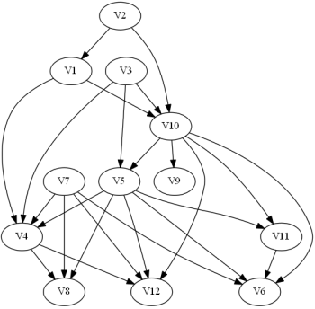
Methodology
Subject | V3 | V2 | V1 | … | ?
1 | 0 | 1 | 1 | … | ?
2 | 0 | 2 | 1 | … | ?
3 | 0 | 2 | 1 | … | ?
… | … | … | … | … | ?
? | ? | ? | ? | … | ?

Slide 16
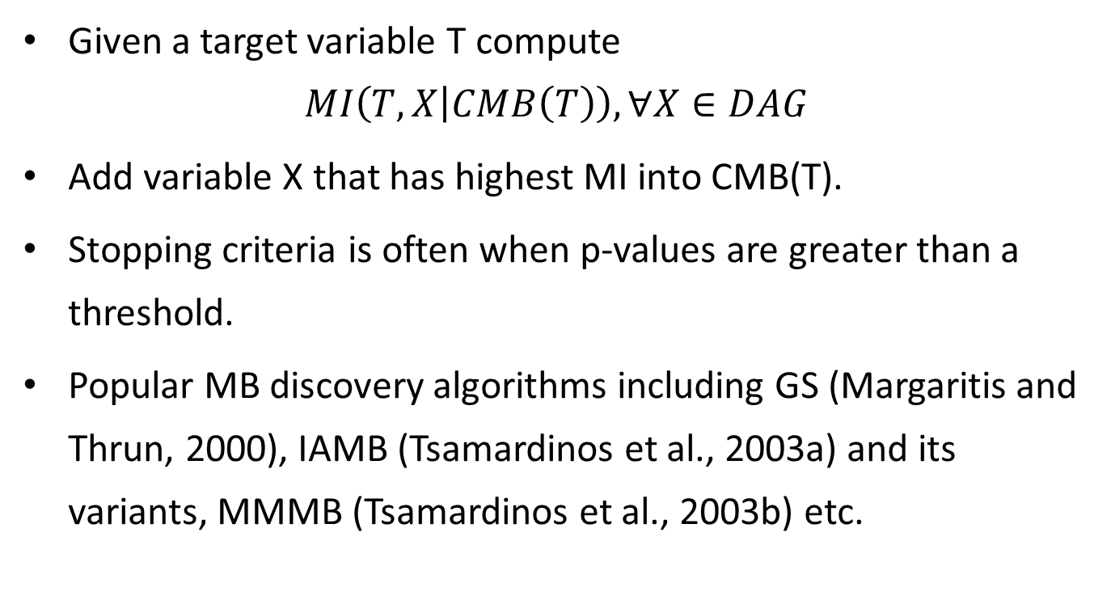
MB Discovery
Given a target variable T compute $MI\left(T, X | CMB\left(T\right)\right), ∀X∈DAG$
Add variable X that has highest MI into CMB(T).
Stopping criteria is often when p-values are greater than a threshold.
Popular MB discovery algorithms including GS (Margaritis and Thrun, 2000), IAMB (Tsamardinos et al., 2003a) and its variants, MMMB (Tsamardinos et al., 2003b) etc.

Slide 17
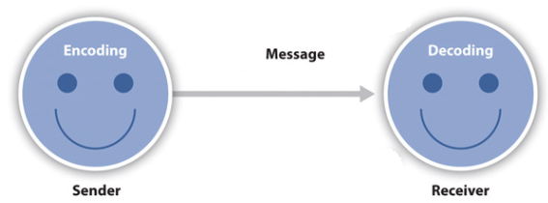
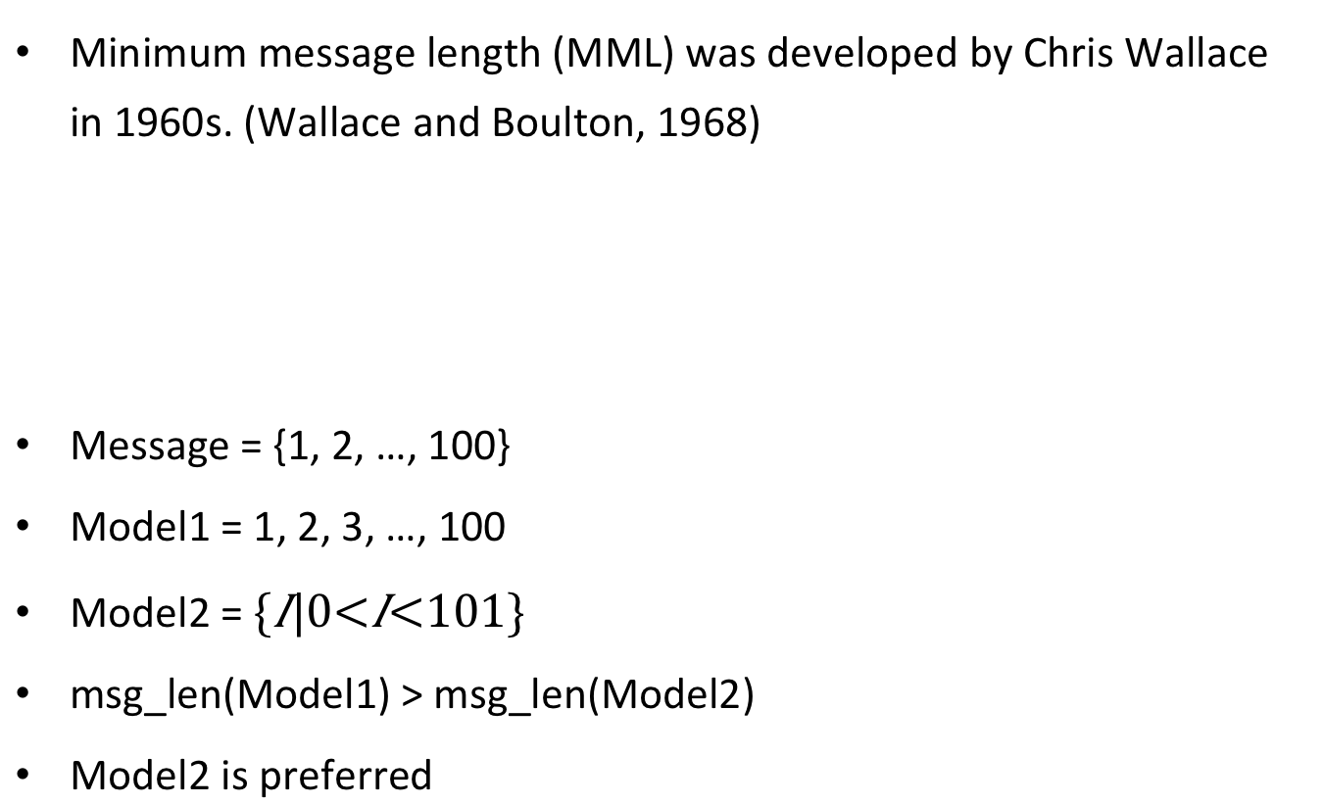
Minimum Message Length
Minimum message length (MML) was developed by Chris Wallace in 1960s. (Wallace and Boulton, 1968)
Message = {1, 2, …, 100}
Model1 = 1, 2, 3, …, 100
Model2 =
msg_len(Model1) > msg_len(Model2)
Model2 is preferred

Slide 18
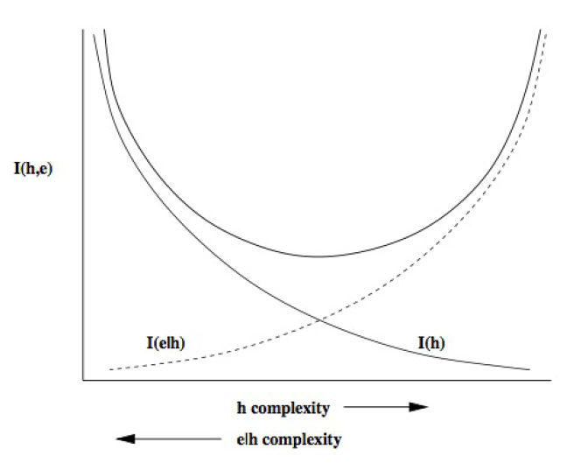
The best model is the one with the minimum overall message length.
MML is a two part message length
Prevent model overfitting
I(H, D) = I(H)+I(D|H)
Message length of a hypothesis
Message length of data given such a hypothesis

Slide 19
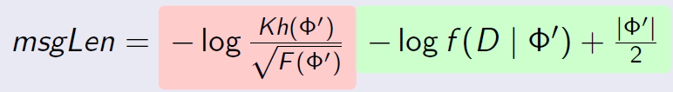
Difficult to get exact MML formula in practice.
An approximation of MML (MML87) is often used (Wallace and Freeman, 1987)
MML is Bayesian – considers parameter prior.

Slide 20

What model to be used?
First-order logistic regression model
Forms a prediction problem;
Gives a sub-exponential representation.
Ideally, we want to find the model that gives the best prediction, this is equivalent to find the MB of the target.

Slide 21
MB Discovery Using MML
Our algorithm uses greedy search and MML to find MBs.
Calculate the MML score.
Add the variable with the minimum score to the current MB.
It stops when adding variables increases the MML score.

Slide 22
Bibliography
J. Cheng, R. Greiner, J. Kelly, D. Bell, and W. Liu. Learning Bayesian networks from data: An information-theory based approach. 137(1-2):43–90, 2002.
G. F. Cooper and E. Herskovits. A Bayesian method for the induction of probabilistic networks from data. Machine Learning, 9(4):309–347, 1992.
D. Heckerman and D. Geiger. Learning Bayesian networks: a unification for discrete and Gaussian domains. In In UAI95 - Proceedings of the Eleventh Conference on Uncertainty in Artificial Intelligence, volume 11, pages 274–284, San Francisco, 1995.
D. Margaritis and S. Thrun. Bayesian network induction via local neighborhoods. In Advances in Neural Information Processing Systems 12, pages 505–511, 2000.
P. Spirtes and C. Glymour. An algorithm for fast recovery of sparse causal graphs. Social Science Computer Review, 9(1):62–72, 1991.
I. Tsamardinos, C. F. Aliferis, A. R. Statnikov, and E. Statnikov. Algorithms for large scale Markov blanket discovery. In FLAIRS Conference, pages 376–381, 2003a.
I. Tsamardinos, C. F. Aliferis, and A. Statnikov. Time and sample efficient discovery of Markov blankets and direct causal relations. In Proceedings of the ninth ACM SIGKDD International Conference on Knowledge Discovery and Data Mining, pages 673–678. ACM, 2003b.
I. Tsamardinos, L. E. Brown, and C. F. Aliferis. The max-min hill-climbing Bayesian network structure learning algorithm. Machine Learning, 65(1):31–78, 2006.
C. S. Wallace and D. M. Boulton. An information measure for classification. The Computer Journal, 11(2):185–194, 1968.
C. S. Wallace and P. R. Freeman. Estimation and inference by compact coding. Journal of the Royal Statistical Society, 49(3):240–265, 1987.
C. S. Wallace, K. B. Korb, and H. Dai. Causal Discovery via MML. In Proceedings of the Thirteenth International Conference on Machine Learning, pages 516–524, 1996.

Slide 23
Thank you for your attention!

